Slide 1
Unleashing the power of PowerShell in VS-Code
Christoph Bergmeister

Slide 2

Agenda
Overview
Templates
Debugging
Settings
Tab Completion for Splatting
Testing
Code Formatting
Code Analysis

Slide 3
Get-Help about_me
First self-discovered PowerShell (probably v2) by accident whilst browsing apps in Windows and thought it’s Cygwin clone and moved on with my (uni) life
Got introduced to PowerShell as developer in my first job
Got into CI-CD and started to get addicted to PowerShell
Started contributing to PowerShell and PSScriptAnalyzer, later became MVP
Became a platform engineer, then an SRE team lead at banking startup
Became a senior DevOps Manager at Avanade but still technical

Slide 4
Introduction

Slide 5
If you like this talk you might also like those
Optimizing Visual Studio Code for PowerShell Development - Justin Grote - PSConfEU 2022 – YouTube
Using Visual Studio Code as Your Default PowerShell Editor by Tyler Leonhardt - YouTube
Using Visual Studio Code as your Default PowerShell Editor - YouTube

Slide 6
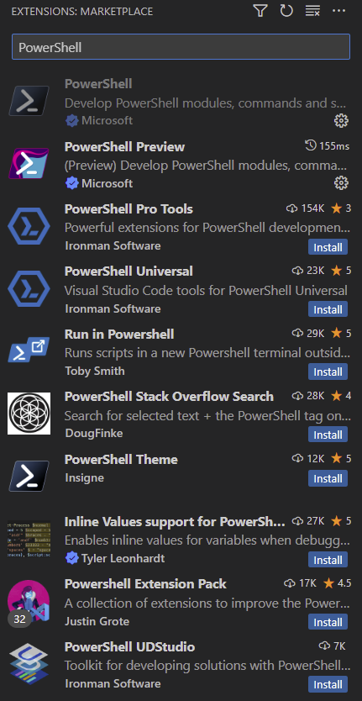
PowerShell extension for VS-Code
Open source here:
https://github.com/PowerShell/vscode-powershell

Slide 7
TEMPLATES, COMMANDS, Integrated Terminal DEMO

Slide 8
DEBUGGING DEMO
Create launch.json from scratch
More sophisticated example: PSScriptAnalyzer/launch.json at master · PowerShell/PSScriptAnalyzer · GitHub
All Demos at pssa-demo/1_DefaultExperience at main · bergmeister/pssa-demo (github.com)

Slide 9
Settings DEMO
settings.json
Example: PSScriptAnalyzer/settings.json at master · PowerShell/PSScriptAnalyzer · GitHub

Slide 10
Testing DEMO
Running Pester

Slide 11
PSScriptAnalyzer
Extension uses this PowerShell module for code analysis and formatting: https://github.com/PowerShell/PSScriptAnalyzer
Docs now on learn.microsoft.com:
PSScriptAnalyzer module - PowerShell | Microsoft Learn
Interaction happens indirectly via generic backend solution: https://github.com/PowerShell/PowerShellEditorServices
Caveat: Extension/PowerShellEditorServices uses different defaults

Slide 12
Splatting DEMO
Tab Completion in the editor 🤯

Slide 13
Formatting

Slide 14
Formatting
Main style can be controlled via this setting: powershell.codeFormatting.preset
Examples of styles are here: There is no One True Brace Style · Issue #81 · PoshCode/PowerShellPracticeAndStyle (github.com)

Slide 15
Formatting
Non default settings to make your life better:
powershell.codeFormatting.autoCorrectAliases
powershell.codeFormatting.useConstantStrings
powershell.codeFormatting.useCorrectCasing
powershell.codeFormatting.whitespaceBetweenParameters
powershell.codeFormatting.pipelineIndentationStyle

Slide 16
Code Analysis

Slide 17
Code Analysis
Not all rules are on by default!
https://github.com/PowerShell/PowerShellEditorServices/blob/ed655ae481c0d4a3b7ee7c6626b3c9e6d5010c5e/src/PowerShellEditorServices/Services/Analysis/AnalysisService.cs#LL63-L79C11

Slide 18
Code Analysis
How to turn on (almost) all rules: Add a PSScriptAnalyzer settings file and add an empty hash table: @{}
💡Tip: If named PSScriptAnalyzerSettings.psd1 and placed in the root of the workspace, it gets picked up automatically, otherwise use this setting to define path to it: powershell.scriptAnalysis.settingsPath

Slide 19
Code Analysis
Code Analysis Rules can be configured in more detail by adding to the settings file: AvoidUsingCmdletAliases - PowerShell | Microsoft Learn
⚠️Compatibility rules cannot do anything without configuration
One can create custom rules as well: Creating custom rules - PowerShell | Microsoft Learn

Slide 20
Thank you
Christoph Bergmeister
Twitter: @CBergmeister
GitHub: @bergmeister

